Slide 1


Linear Regression
By: Sidhidatri Nayak
CDAC,NOIDA,India

Slide 2
Notice regarding the usage of images:
This document contains images obtained by routine Google
Images searches. Some of these images may perhaps be under
copyright. They are included here for educational and
noncommercial purposes and are considered to be covered by
the doctrine of Fair Use. In any event they are easily available
from Google Images.

Slide 3
Objectives
What is Regression?
Regression Analysis
Applications of Regression
Simple linear regression through Least Squares Method
Coefficient of Determination
Using the Estimated Regression Equation for Estimation and Prediction
Multiple Linear Regression
Implementation in Python

Slide 4
Regression
regression is a supervised machine learning algorithm.
Statistical process of estimating the relationship among variables.
There are two types of variables .
Dependent variable , whose value is influenced or is to be predicted
Independent Variable, which influences the value and is used for prediction.
It shows the relationship between a dependent variable( regressed) and one or more independent variables(predictors/regressor)
The predictor is a continuous variable such as sales, salary, age, product price, etc.
Linear regression algorithm shows a linear relationship between variables through a linear equation

Slide 5
Example
House 1 : x1: 1200sqft y1=200000
House 2 : x2: 1500sqft y2=300000
House 3 : x3: 1800sqft y3=400000
House 4 : x4: 2000sqft y4=500000
House 5: x5: 2200sqft y5=600000
Input( x1,x2,x3,x4,x5)
Output(y1,y2,y3,y4,y5)
The value of y can be predicted from x, the predictor variable.
Y variable is the quantity of interest.

Slide 6
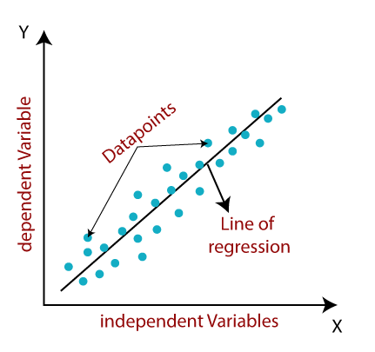

Slide 7
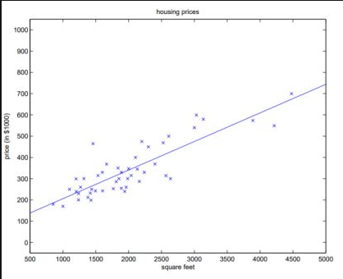
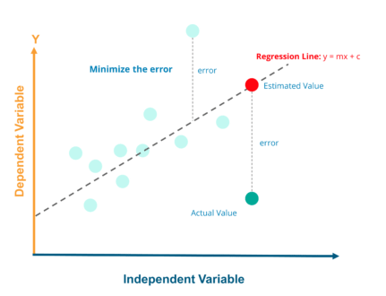
Regression Line

Slide 8
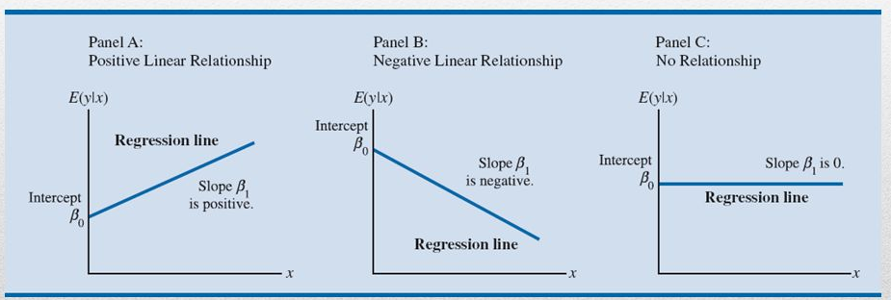
Regression Lines

Slide 9
Applications of Regression
Predictive Analytics
Example:
Evaluating trend and sales estimate
Analyzing the impact of price changes
Assessment of risk in financial services and insurance domain

Slide 10
Regression Analysis
Regression Analysis is the process of developing a statistical model , to predict the value of dependent variable by at least one independent variable.

Slide 11
The Simple Linear Regression Model
Simple Linear Regression Model
y = β₀ + β₁x + ε
Simple Linear Regression Equation
E(y) = β₀ + β₁x

Slide 12

Estimated Simple Linear Regression Equation
= b₀ + b₁x
bo=the y-intercept line of the estimated regression line.
b1=the slope of the estimated regression line.
=the predicted value for quarterly sale and xi the size of student population
$$\hat{y}$$

Slide 13
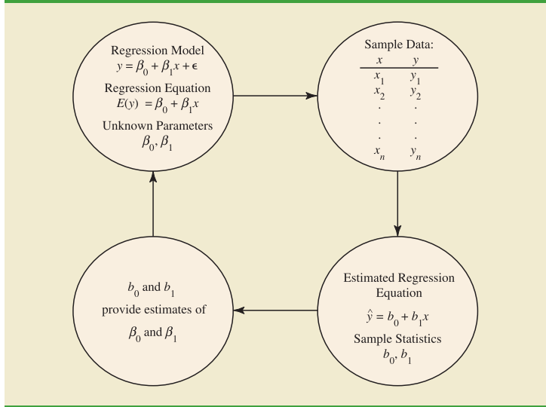
Estimation Process

Slide 14
Example
ABC café chain located in different cities of India. It is more popular near the university campus. The manager believes that the quarterly sales for the café ( denoted by y) are related to the size of the student population (denoted by x).
That is cafes that is near to university campus with large student population may generate more sales compared to others.
Using regression analysis we can develop an equation showing how the dependent variable y is related to the independent variable x.

Slide 15
Table1 of sample data

Slide 16
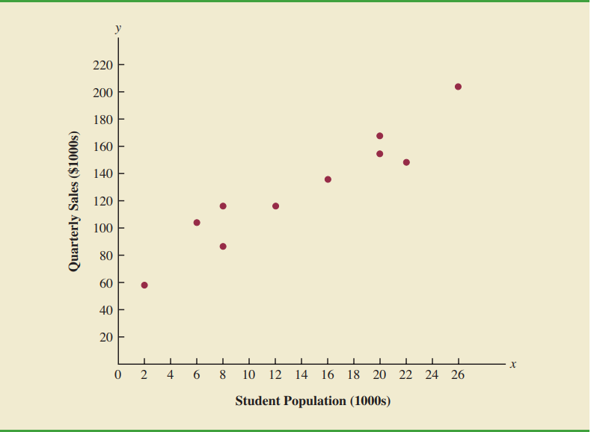
Scatter Plot

Slide 17
Least Squares Method
Least Squares Criterion
where:
y_{i} = observed value of the dependent variable
for the ith observation
y_{i} = estimated value of the dependent variable
for the ith observation
^

Slide 18
Estimated Simple Linear Regression Equation
= b0 + b1x
bo=the y-intercept line of the estimated regression line.
b1=the slope of the estimated regression line.
=the predicted value for quarterly sale and xi the size of student population
Or in short
$$\hat{y}$$

Slide 19
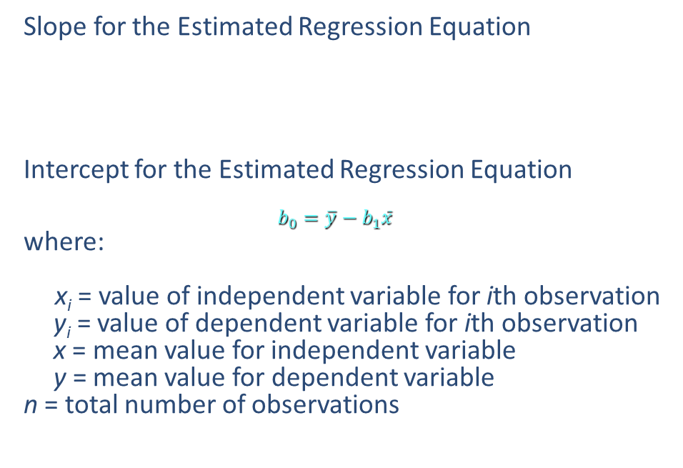

The Least Squares Method
Slope for the Estimated Regression Equation
Intercept for the Estimated Regression Equation
$$b_{0}=\overline{y}−b_{1}\overline{x}$$
where:
x_{i} = value of independent variable for ith observation
y_{i} = value of dependent variable for ith observation
x = mean value for independent variable
y = mean value for dependent variable
n = total number of observations
$$b_{1}=\frac{\sum{\left(x_{i}−\overline{x}\right)\left(y_{i}−\overline{y}\right)}}{\sum{{\left(x_{i}−x\right)}^{2}}}$$
_
_

Slide 20
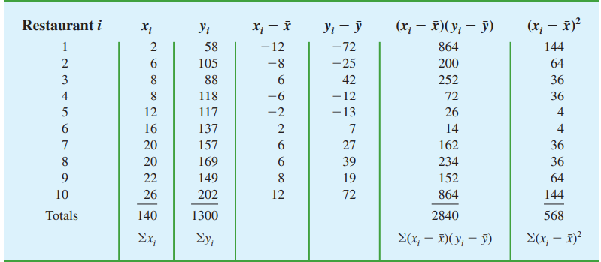
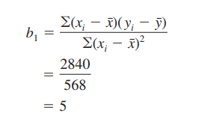
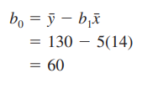
calculating the least squares estimated regression equation for ABC cafe

Slide 21
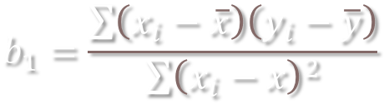


Put it in the formula
$$b_{0}=\overline{y}−b_{1}\overline{x}$$
b1=2840/568=5
b0=130-5(14)=60
Thus the estimated regression equation is $\hat{y}$=60+5x

Slide 22
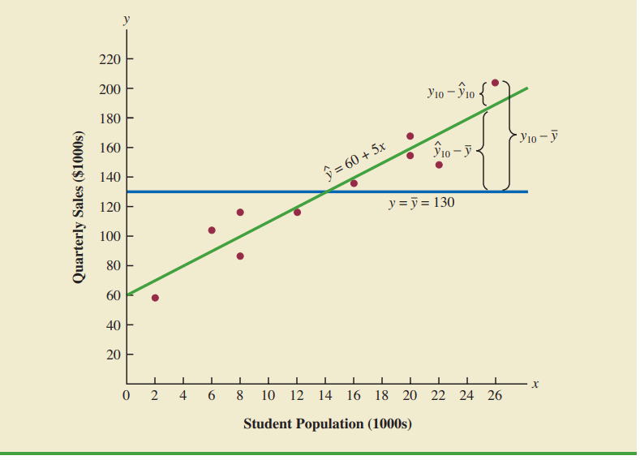

Thus the estimated regression equation is $\hat{y}$=60+5x

Slide 23
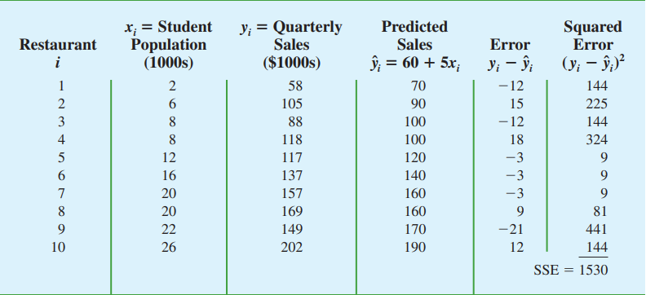
SSE

Slide 24
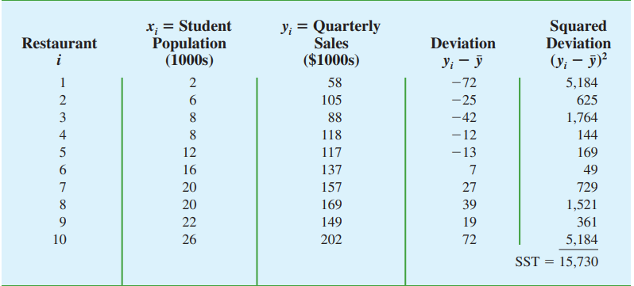
SST

Slide 25
The Coefficient of Determination
Relationship Among SST, SSR, SSE
SST = SSR + SSE
Coefficient of Determination
r² = SSR/SST
where:
SST = total sum of squares
SSR = sum of squares due to regression
SSE = sum of squares due to error
^
^

Slide 26
Finding SSR and r²
SSR=SST-SSE=15730-1530=14200
Coefficient of Determination
r² = SSR/SST = 14200/15730 = .9027

Slide 27
The Correlation Coefficient
Sample Correlation Coefficient
where:
b₁ = the slope of the estimated regression
equation

Slide 28
Example: ABC Cafe
Sample Correlation Coefficient
There is strong positive linear association between x and y

Slide 29
Mean Square Error

Slide 30
mean square error
An Estimate of s 2
The mean square error (MSE) provides the estimate
of s 2, and the notation s2 is also used. MSE = SSE/(n-2)

Slide 31
Testing for Significance
An Estimate of σ
To estimate σ we take the square root of σ ².
The resulting s is called the standard error of the estimate

Slide 32
MSE=SSE/(n-2)
MSE=1530/8=191.25
S=13.829
The predictive precision of the linear regression model using evaluation metrics such as the mean square error.

Slide 33
The Multiple Regression Model
The Multiple Regression Model
y = β₀ + β₁x₁ + β₂x₂ + . . . + β_{p}x_{p} + ε
The Multiple Regression Equation
E(y) = β₀ + β₁x₁ + β₂x₂ + . . . + β_{p}x_{p}
The Estimated Multiple Regression Equation
y = b₀ + b₁x₁ + b₂x₂ + . . . + b_{p}x_{p}
^

Slide 34
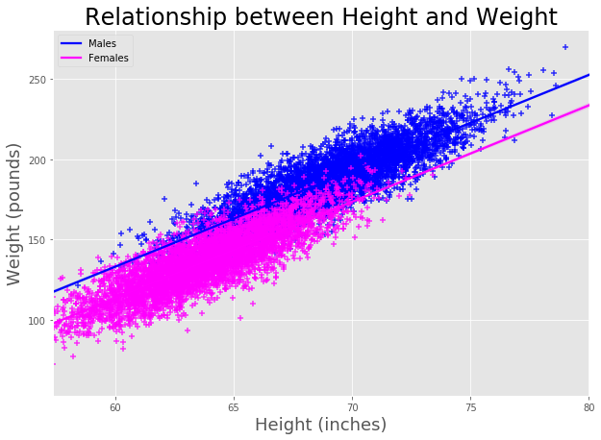

Slide 35
use case 1
Business Problem: An ecommerce company wants to measure the impact of product price, product promotions, and holiday seasonality on product sales.
Input Data:
Predictor/independent variables include product price data, product promotions data such as discounts, flag representing presence/absence of seasonality.
The dependent variable is product sales data.

Slide 36
Use case2
Business Problem: An agriculture production firm wants to predict the impact of the amount of rainfall, humidity, and temperature on the yield of particular crop.
Input Data:
Predictor/independent variables include the amount of rainfall during monsoon months, the humidity levels/measurements, and the temperature measurements.
The dependent variable is crop production.

